Slide 1
Texan Demographics Consulting Group

Slide 2
A Demographic Profile of Texas Counties in the Hill Country Alliance
Prepared by: Texan Demographics Consulting Group

Slide 3
Introduction
Goal: to create a demographic profile of the Texas Hill Country counties.
Understand the demography in order to identify the people of the Hill Country and their economic and physical trends over time.

Slide 4
Project Description
Assist the HCA in raising awareness concerning the preservation of the Texas Hill Country.
Identify various demographic changes over time.

Slide 5
Work Accomplished -Every decade’s data has been collected (1970,80,90,00) -Data has been modified from original form, organized, and managed -Data is GIS compatible Work in Progress -Solve minor problems with attribute information -Creation of time-series maps -Outlining significant demographic trends -Standardization Work Planned -Editing of metadata for each decade -Posting and updating website -Collect additional data that may benefit project -Include suggestions for HCA/ planners
Progress Evaluation

Slide 6
Timeline

Slide 7
Project Tasks
Project | Individual Tasks
Table Creation | Collect, organize, and transpose data based on feedback from HCA and Marston
Formatting | Manipulating data into a GIS compatible format
Joins | Joining Census data to the HCA geography
Map Making | Displaying different queries that can be made from the data through symbology and labeling
Reports | Organizing data in a report format showing results of different queries

Slide 8
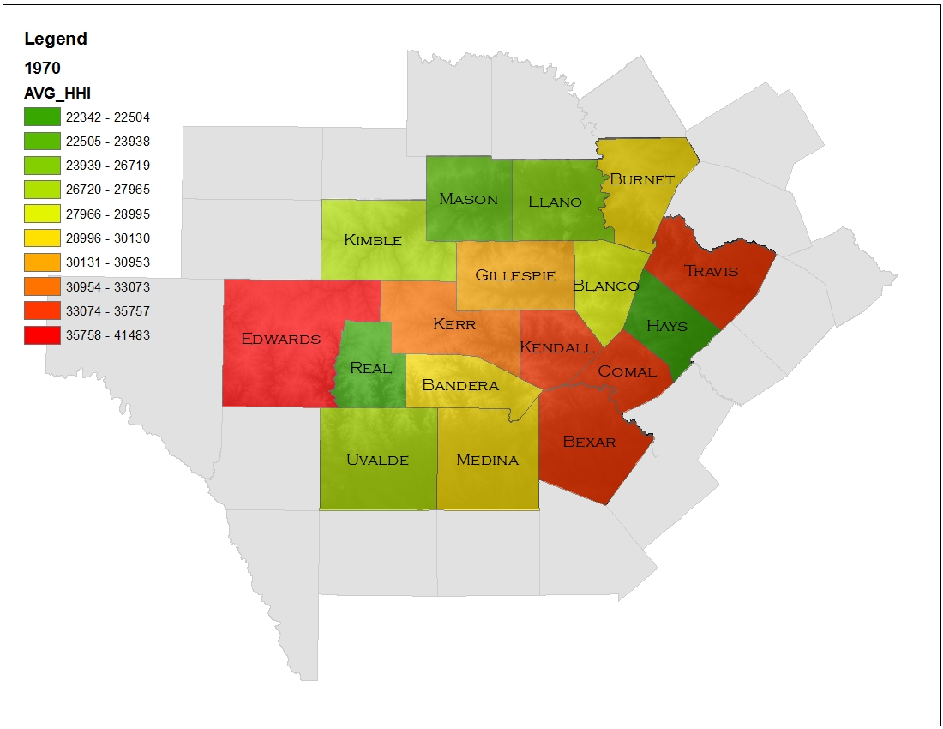
Average House Hold Income in 1970
County geography is chosen for consistency.
Census tract and block geography change over time.

Slide 9
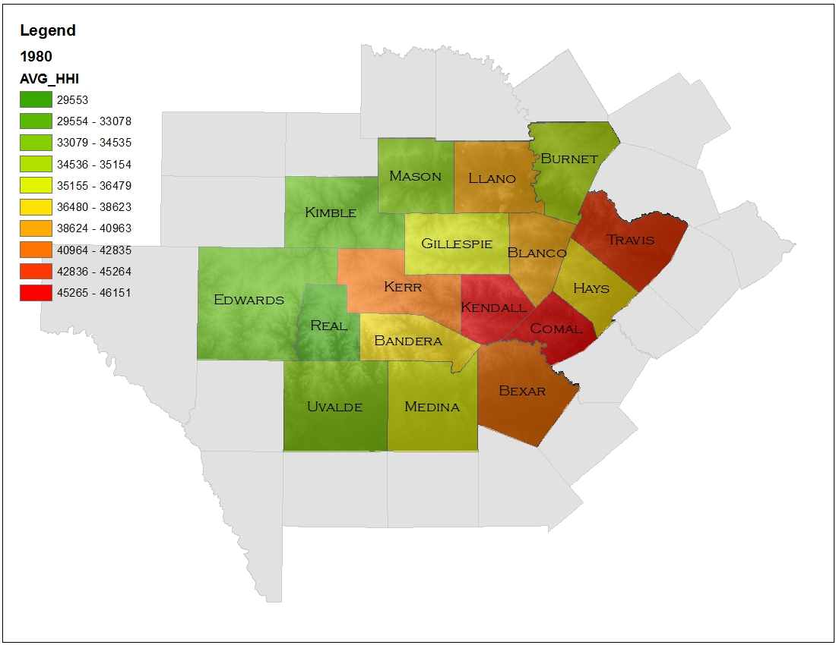
Average House Hold Income in 1980
Each decade changes in counts and averages based on many economic factors.

Slide 10
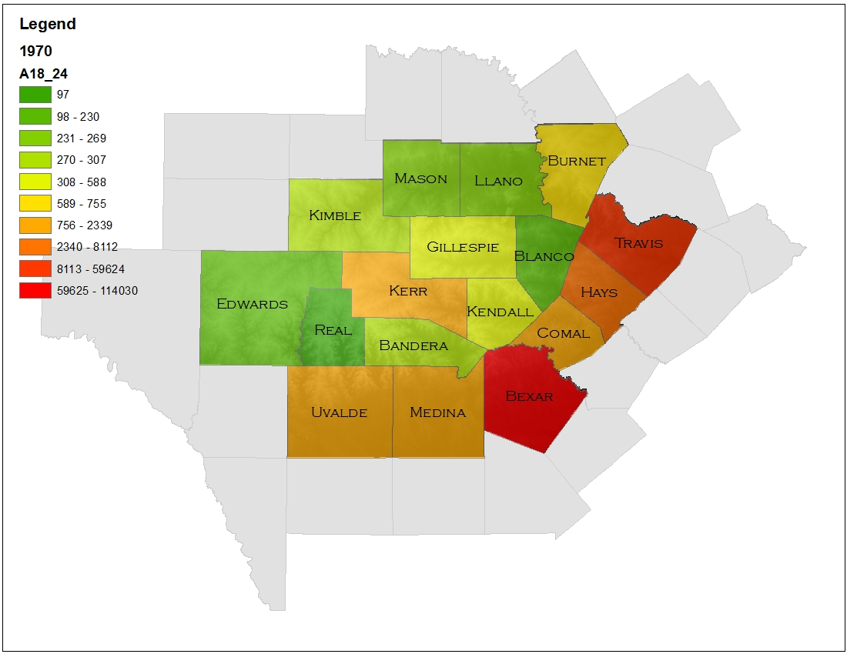
Ages 18 – 24 in 1970
County geography is chosen for consistency.
Census tract and block geography change over time.

Slide 11
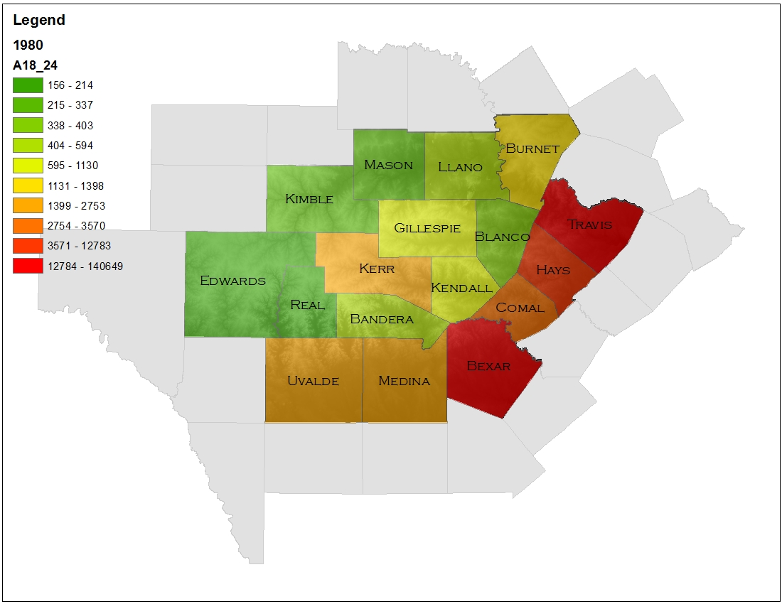
Ages 18 – 24 in 1980
Population counts change each decade based on many factors.

Slide 12
Questions???

